Slide 1

Quantum Risk Analysis
An Introduction
Lecture 2/3

Slide 2
01
Introduction
02
Quantum Computers
03
Risk profiling
04
Credit risk analysis
05
Classical Methods of Risk Analysis
Quantum Risk Analysis
06
Quantum Risk Analysis
07
Applying the quantum algorithm
Design by PresentationGO.com
08
Sources of Error
09
Advantages of Quantum Risk Analysis
10
Conclusions

Slide 3
In this lecture
06
Quantum Risk Analysis
07
Applying the Quantum algorithm
Design by PresentationGO.com

Slide 4


Quantum Risk Analysis
Quantum amplitude estimation (QAE) algorithms: assess VaR and CVaR on gate-based computer.
Quantum Computers provide quadratic speedup for algorithms.
IBM Quantum Computers
https://www.hpcwire.com/off-the-wire/the-quantum-institute-of-the-university-of-sherbrooke-joins-the-ibm-q-network/
https://arstechnica.com/science/2016/05/how-ibms-new-five-qubit-universal-quantum-computer-works/
6

Slide 5
Applying the Quantum Algorithm
Operator A acting on n + 1 qubits:
(1)
Estimation of a, where y$∈\left\{0,…M−1\right\}$ and M = 2^{m} :
(2)
Estimation of a satisfies:
(3)
(4)
https://www.nature.com/articles/s41534-019-0130-6
https://arxiv.org/pdf/1907.03044.pdf
(5)
7.1

Slide 6
Applying the Algorithm (part 2)
Measuring VaR:
Variance of random variable X:
(6)
Calculating VaR_{𝛼}: ℙ[X≤𝑥]≥(1−𝛼)
(7)
Operator F acting on
(8)
Probability of measuring |1⟩ for the last qubit:
(9)
such that l_{𝛼} = VaR_{𝛼}
(10)
(11)
7.2
https://www.nature.com/articles/s41534-019-0130-6

Slide 7
Applying the Algorithm (part 3)
Two-asset portfolio
Worth of portfolio formula:
(12)
To calculate daily risk of portfolio: r_{i} = r_{i,0}+ δr_{i} i=1,2 (13)
(14)
(15)
((5))
7.3
https://www.nature.com/articles/s41534-019-0130-6#Sec2

Slide 8
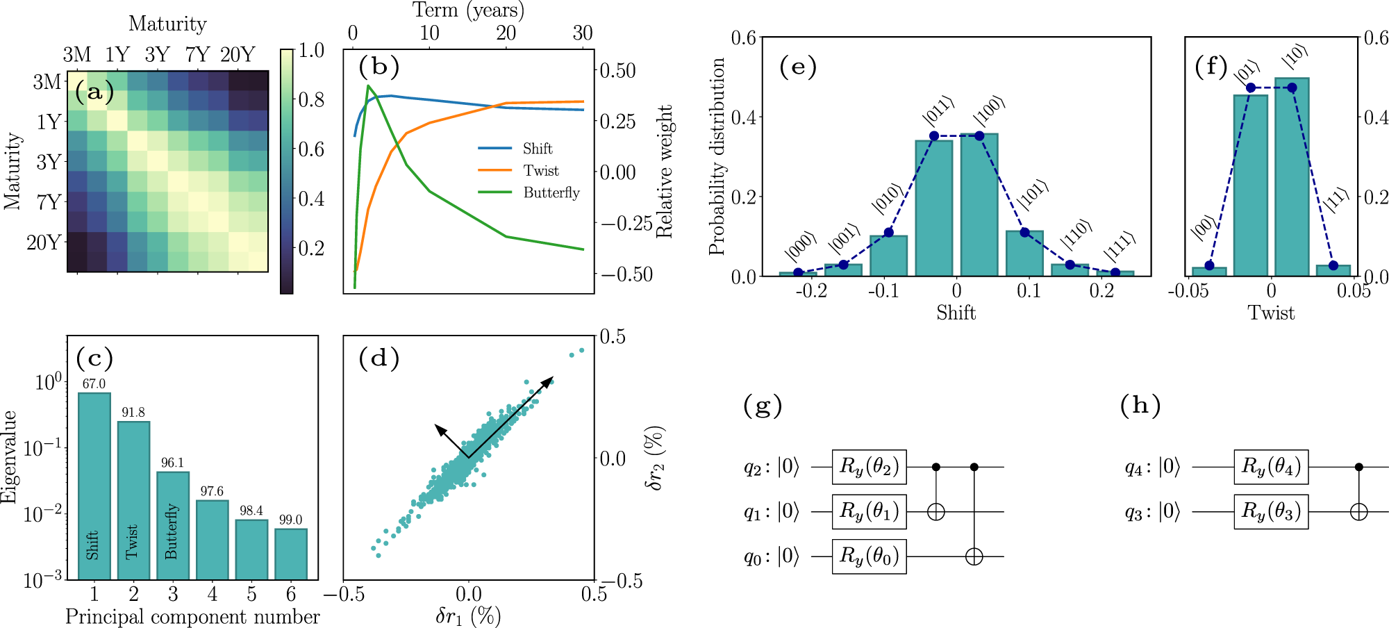
Applying the Algorithm (part 4)
The Quantum Circuit:
(16)
(17)
https://www.nature.com/articles/s41534-019-0130-6#Sec2
https://arxiv.org/pdf/1907.03044.pdf
7.4

Slide 9
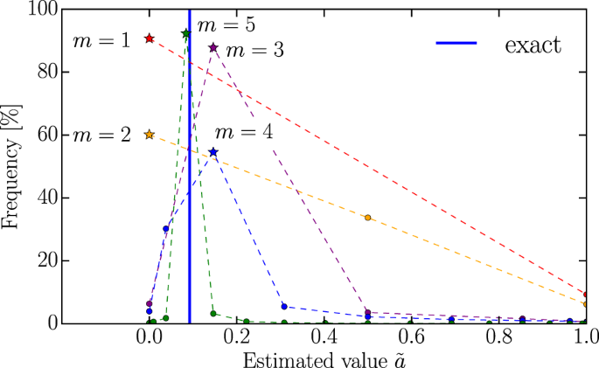
Applying the Algorithm (part 5)
(18)
7.5
https://www.nature.com/articles/s41534-019-0130-6#Sec2

Slide 10
08
Sources of Error
In the next lecture…
09
Advantages of Quantum Risk Analysis
10
Conclusions
Design by PresentationGO.com

